Slide 1


HEART DISEASE PREDICTION
Created On: 13-09-2022
Published On: 16-09-2022

Slide 2

INDEX
S.NO | TITLE | Slide/Page No
1) | Overview | 3
2) | Contents(Steps, Technologies & Tools Used) | 4
3) | Result of Predictive Analysis of Heart disease – ML Model(Logistic regression, Decision Tree & SVM model). | 5
4) | Result of Fast API Application after hosting the SVM Model | 6
5) | Dockerization of API | 7
6) | Database Connection(MYSQL) | 8
7) | Deploying API to cloud Via GitHub Or Docker Container | 9-10
8) | Exposing the API to User | 11
Heart Disease Prediction

Slide 3
Overview
Problem Statement: | Predicting probability of heart disease in patients.
Context: | Now-a-days, The leading cause of death is heart disease. Therefore there needs to be work done to help prevent the risks of having a heart attack or stroke.
Detail: | This dataset consists of features that can be used to predict which patients have a high risk of heart disease.
Solution Approach: | Building an ML Model and hosting it using Fast API and deploying it to Azure Cloud and Exposing the API to World for identifying the heart disease.
End- User: | Doctor – Cardiologist Or General Physician
Heart Disease Prediction

Slide 4
Contents(Steps, Technologies & Tools Used)
Steps:
1) Predictive Analysis of Heart disease – ML Model(Logistic regression, Decision Tree & SVM model).
2) Built an Fast API to host the ML Model.
3) Dockerized the API(Using Docker Desktop & Docker Hub).
4) Created MYSQL Database in Azure Cloud & Local system.
5) Deployed the API to Azure cloud(Using Github & Docker Container).
6)Exposed the API to the end-user.
Technologies & Tools Used:
Technology: Python, HTML, CSS.
Tools: Git-Hub, Docker Desktop & Docker Hub.
Cloud: Azure Cloud Services –App Services, DB Server.
Databases: MYSQL.
Heart Disease Prediction

Slide 5
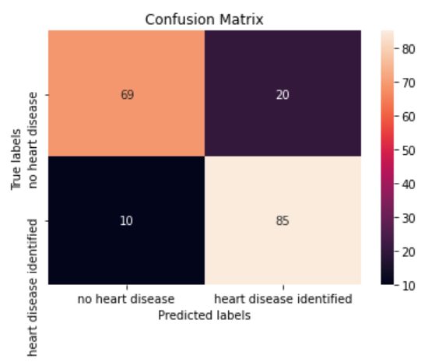

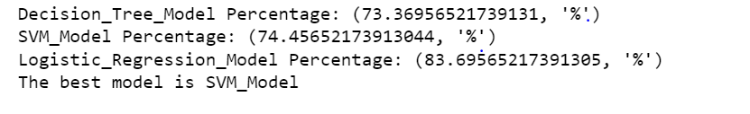
Result of Predictive Analysis of Heart disease – ML Model(Logistic regression, Decision Tree & SVM model).
Dataset: Logistic Regression- Confusion Matrix:
ML Model Accuracy:
Best Model –SVM Model:
SVM Model is chosen for creation of a Pickle file.
The different Chest Pain Types are: ASY, ATA, NAP & TA.
Inputs: Age, Sex, Resting BP, Cholesterol, Fasting BS, Max HR, Exercise Angina, Old Peak, ST_Slope, ASY, ATA, NAP, TA, LVH, Normal, ST, N, Y, Down, Flat, Up.
Outputs: Heart Disease : 1 – Heart Disease Identified, 0 – No Heart Disease.
Heart Disease Prediction

Slide 6
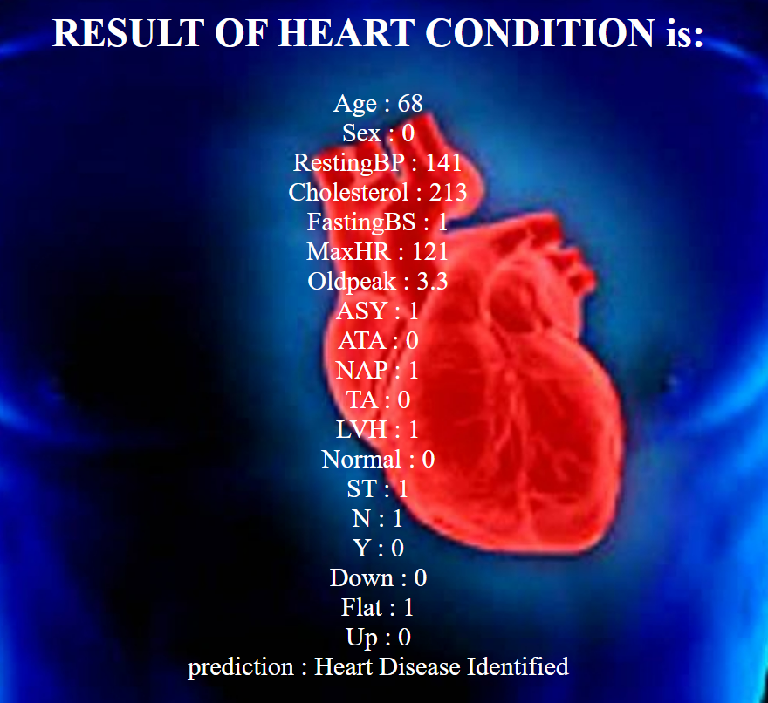
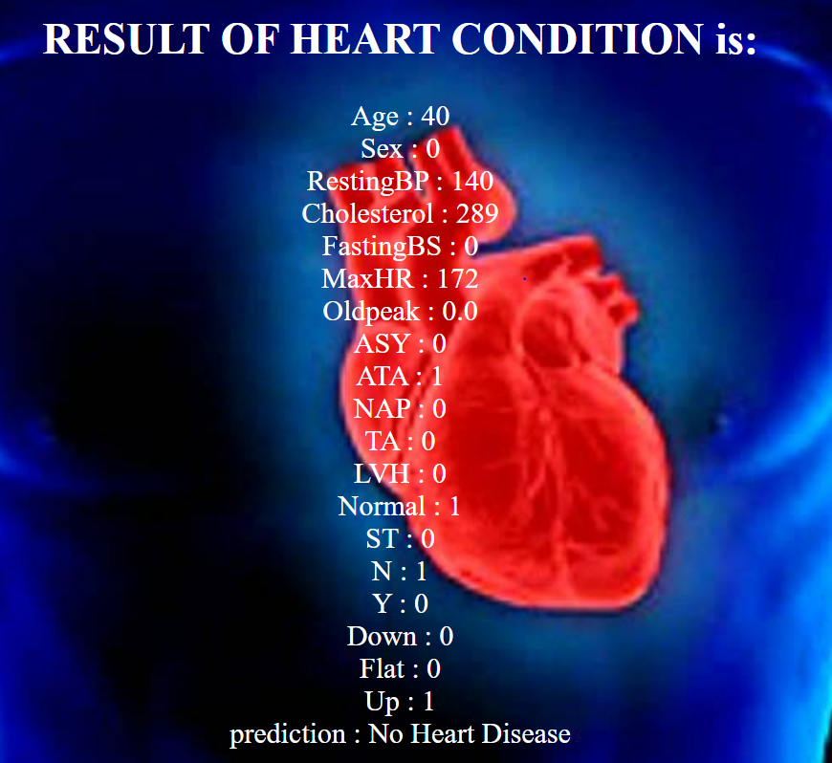
Result of Fast API Application after hosting the SVM Model
Result of API after prediction: Two Samples: Heart Disease Identified, No Heart Disease.
Here, Using API- Predicted whether the heart disease is identified or not.
Heart Disease Prediction

Slide 7
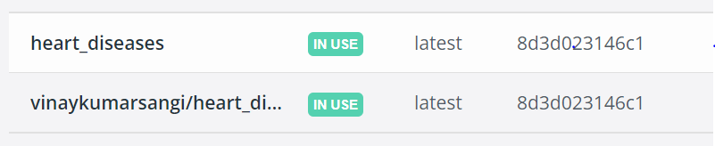
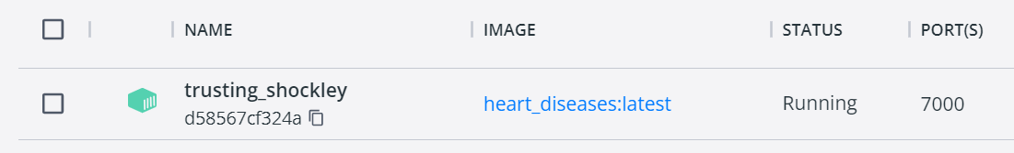
Dockerization of API
Docker Image:
Running the Image using Container:
Building a docker image by cmd run: docker build -t heart_diseases .
Prerequisites for creating Image are: Dockerfile, requirements.txt, Docker desktop.
Run the Image using docker container to host the API by cmd run: docker run -d -p portno:portno heart_diseases
Login into docker desktop using hub credentials by cmd run: docker login
Tag your Image to hub by cmd run: docker tag heart_diseases username/heart_diseases
Push your Image to docker hub: docker push username/heart_diseases
Try running the Image to see the results in local(http://127.0.0.1:7000 & http://127.0.0.1:7000/docs).
Check the predictions for testing purpose.
Heart Disease Prediction

Slide 8
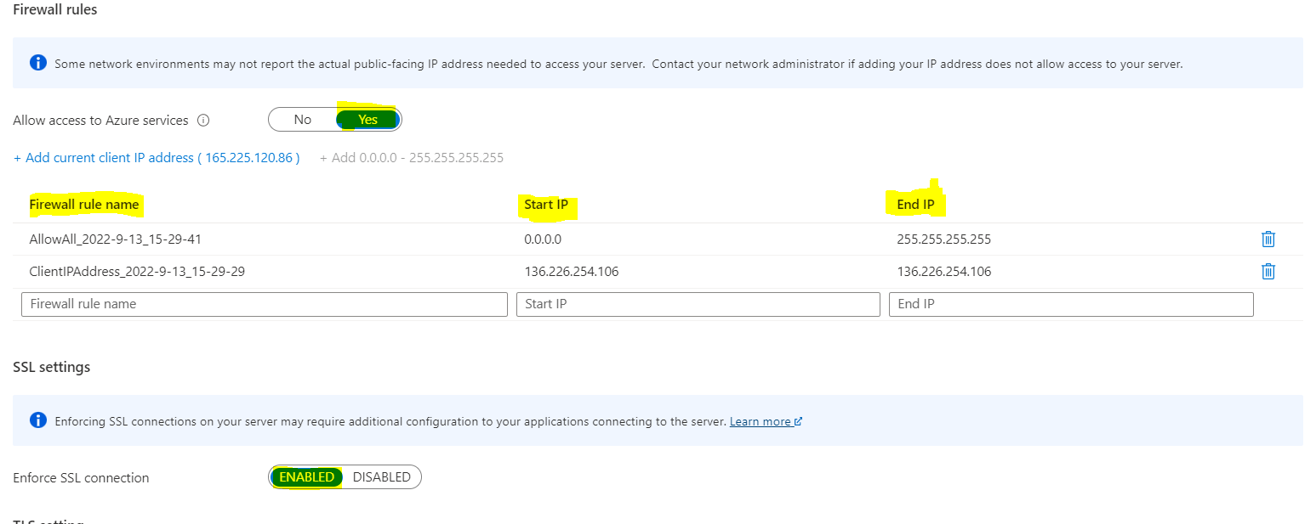
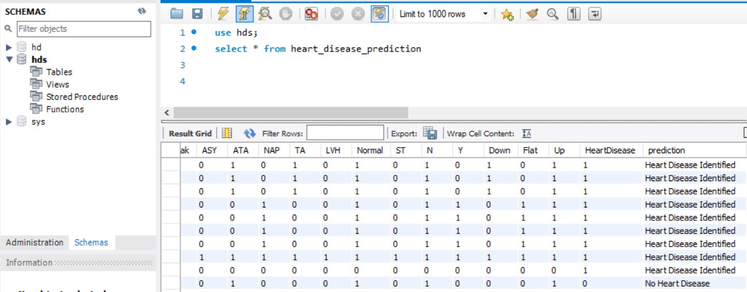
Database Connection(MYSQL)
MYSQL Database:
Create a MYSQL DB on “Azure Database for MySQL Single server.
Connect to the server to local database & Create a schema for the created table
If required, Set the Firewall rules & SSL settings for connecting to Database
Here, For every prediction the entries were created & can be used to take-out the list of Id’s having heart disease.
Heart Disease Prediction

Slide 9
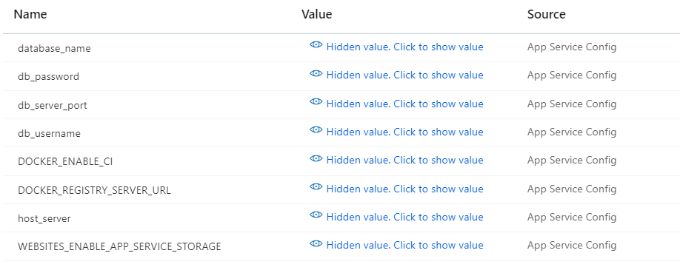
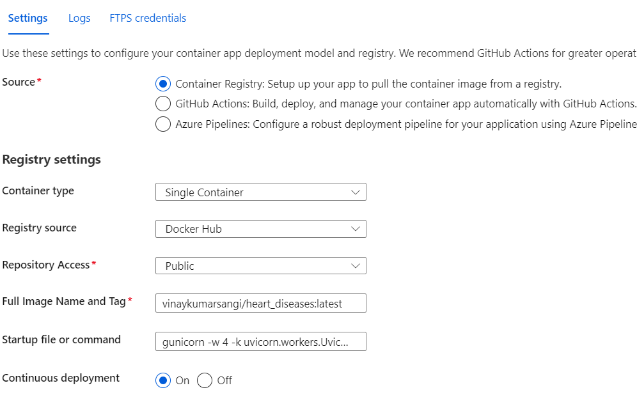
Deploying API to cloud Via GitHub Or Docker Container
Deploy the Docker-Hub Image into Azure Cloud:
Create a App service and configure DB Credentials as shown:
Deploy the Docker Hub Image via by Deployment Center using Container Registry as shown:
Browse the URL(https://hdpredwebappdocker.azurewebsites.net/) to see the API & predict it to see results.
Heart Disease Prediction

Slide 10
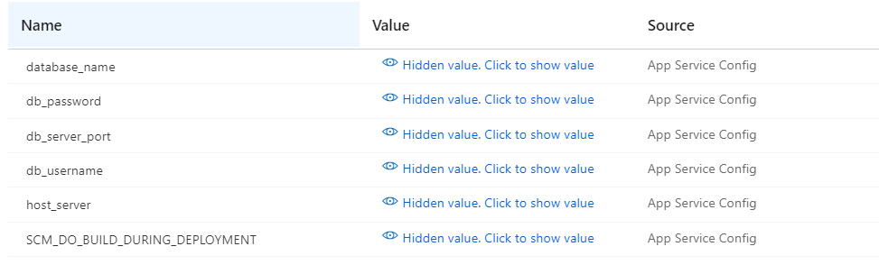
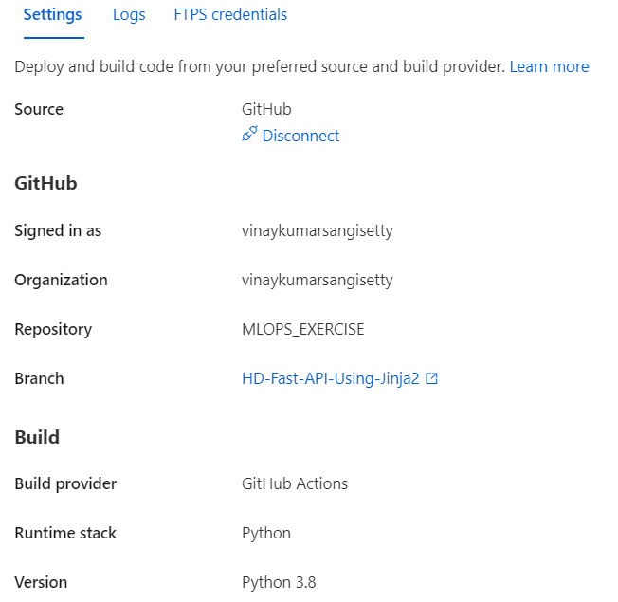
Deploying API to cloud Via GitHub Or Docker Hub
Deploy the code Using GitHub Repo into Azure Cloud:
Create a App service and configure DB Credentials as shown:
Deploy the Code via by Deployment Center using Git hub Actions as shown:
After Build & Deploy Completes, Browse the URL(https://fastapi-vin.azurewebsites.net/) to see the API & predict it to see results.
Heart Disease Prediction

Slide 11
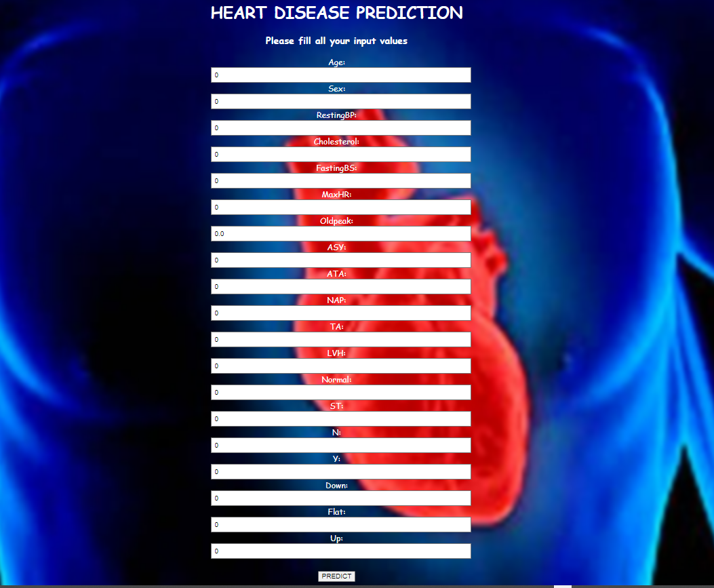
Exposing the API to User
End-User Usage:
Once after browsing the URL User will see the below page to enter the values:
URL: https://fastapi-vin.azurewebsites.net/
https://hdpredwebappdocker.azurewebsites.net/
Fill all the Values & Click on PREDICT Button. Then, User see the results “../Predict/” Page.
In this page, User can see for the entries given along with prediction.
prediction- Heart Disease Identified, No Heart Disease.
This will help the user to prevent the risks of having a heart attack or stroke & maintain proper health condition.
Heart Disease Prediction

